Slide 1
The Periodic Table & Atomic Structure
Chapter 6

Slide 2
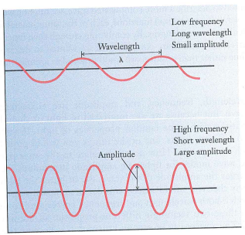

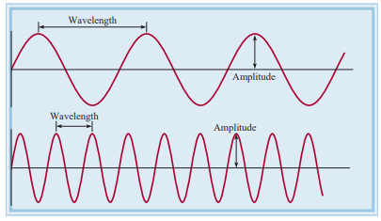
Quantum theory
Max Planck discovered that atoms & molecules emit energy only in certain discrete quantities, or quanta.
Planck’s quantum theory turned physics upside down
Wave a vibrating disturbance by which energy is transmitted.
Wavelength is the distance between peaks of successive (λ, lambda).
Frequency (ν, nu) is the number of waves that pass through a particular point in one second.
Amplitude is the size or height of the wave.
Physicists had always assumed that energy is continuous.

Slide 3
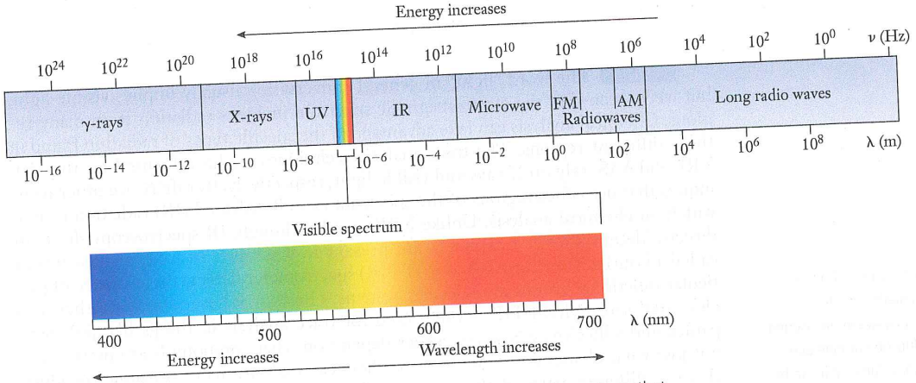
Nature of light
Light could be a collection of packets of energy, called photons. (Albert Einstein)
Bright light has more photons than dim light.
Each photon must possess energy E, and is proportional to its frequency.
E = hν
where ν is the frequency of light & h is Planck’s constant (6.63×10⁻³⁴ J s).
Visible light is a tiny fraction of the electromagnetic spectrum, which includes various rays/waves.

Slide 4
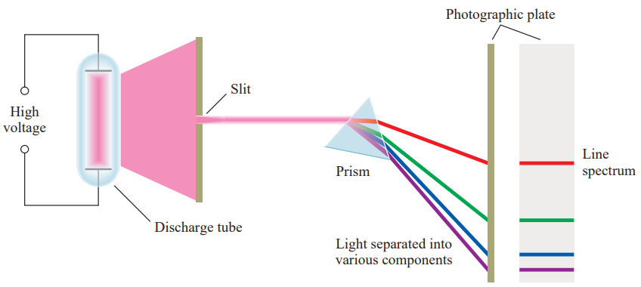
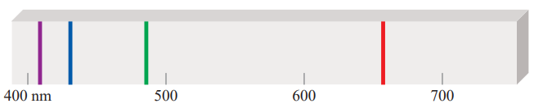
Atomic spectra
The gas under study is in a discharge tube containing two electrodes.
As electrons flow from the negative electrode to the positive electrode, they collide with the gas, which leads to the emission of light by the atoms.
The emitted light is separated into its components by a prism.
Each component color is focused at a definite position, according to its wavelength, and forms a colored image of the slit on the photographic plate.
These line spectra are the light emission only at specific wavelengths.
Fig. An experimental arrangement for studying the emission spectra of atoms and molecules

Slide 5
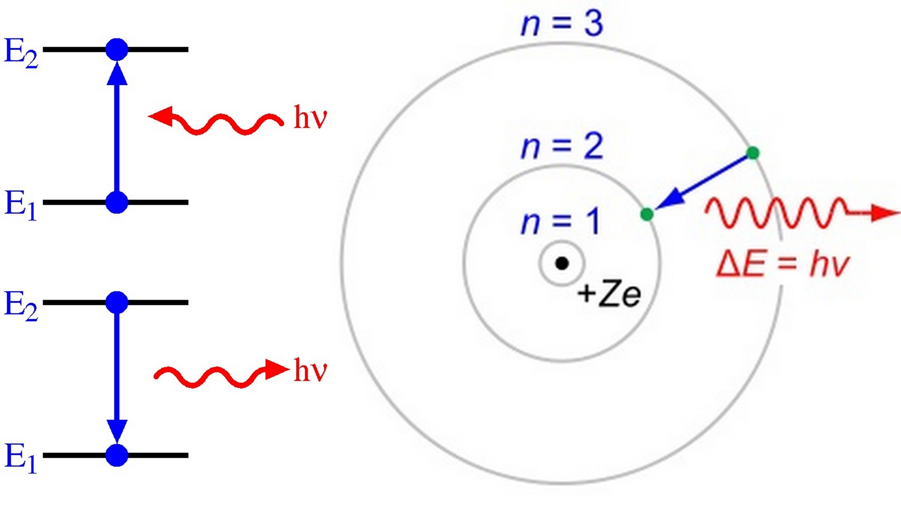
Every element has a unique emission spectrum.
The characteristic lines in atomic spectra can be used in chemical analysis to identify unknown atoms, just like finger prints are used to identify people.
When atom emits light, it is releasing energy to surrounding.
When atom emits light, it goes from higher energy state to lower energy state

Slide 6
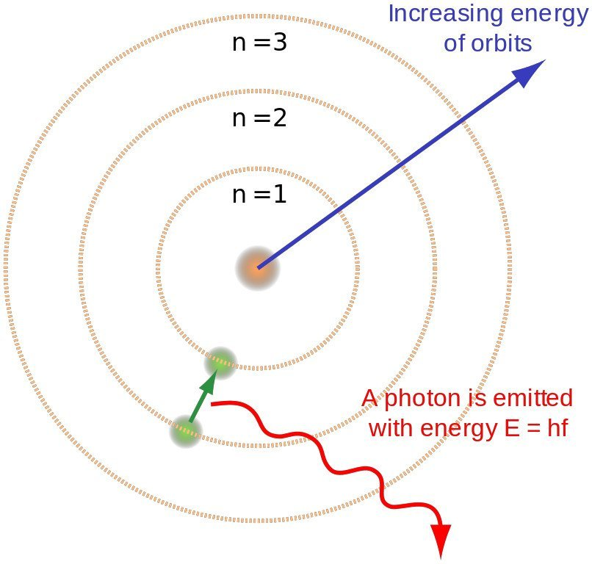
Bohr atomic model
Electrons revolve around the nucleus in a fixed energy levels called orbits/shells without radiating energy
Electrons maybe found in orbits with specific energies. The closer they are to the nucleus, the lesser energy they posses
As long as an electron remains in the shell, it never gains or loses energy
Radiant energy absorbed by the atom causes the electron to move from a lower-energy state (smaller n value) to a higher-energy state (larger n value).
Radiant energy (photon) is emitted when the electron moves from a higher-energy state to a lower-energy state.
n = Principal quantum numbers
Drawback:
It failed to explain the atomic spectra of element with more than 1 electron
The idea of fixed orbital paths is not correct
excited state
Ground state is the lowest energy state of a system
Excited state is higher in energy than the ground state
ground state

Slide 7
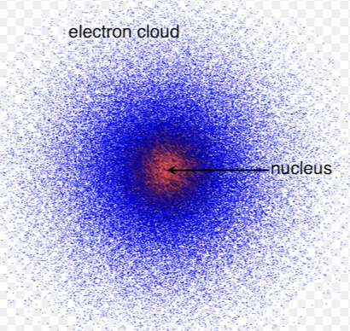
Erwin Schrödinger’s Quantum mechanical model of atom
In Bohr model, electrons are viewed as particles travelling along circular orbits of fixed radius.
In Quantum model, electrons are viewed as waves rather than particles, which are spread out through a region of space called an orbital.
It is the latest model of atom
Extremely organized model describing much electron motion
Electron organization
Electron cloud
Energy levels
Sublevels
Orbitals
Spin

Slide 8
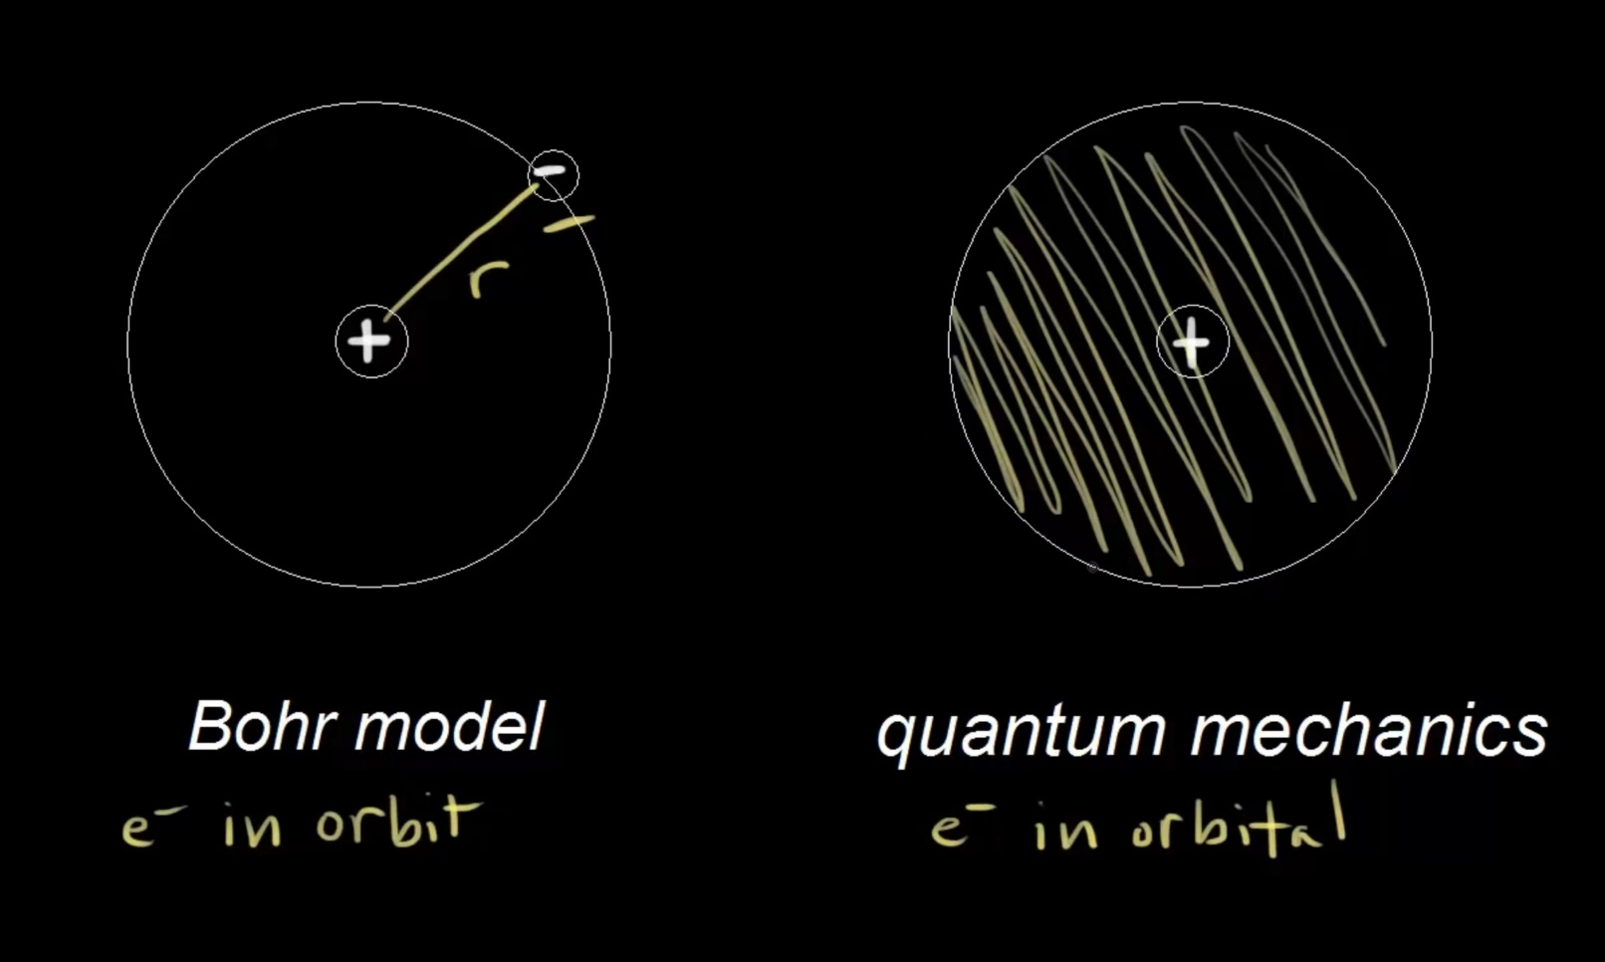
Bohr model is a classical mechanics
Electrons orbits the nucleus, same as planets surround the sun
Electrons maybe found in orbits around the nucleus
In Quantum mechanics, high probability electrons are around the orbital.
Best way to explain electrons in orbitals
The electrons in the orbitals can be described using 4 quantum numbers
Quantum numbers describe the distribution of electrons in hydrogen and other atoms
Quantum numbers are derived from the
Schrödinger equation for the hydrogen atom.
1. Principal quantum numbers (n)
2. Secondary quantum numbers
3.

Slide 9
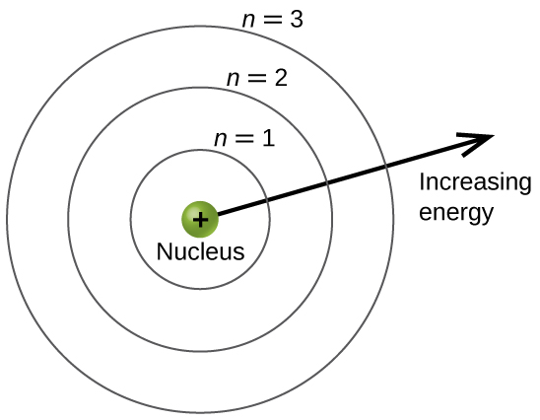
Quantum numbers
The four quantum numbers n, l, m_{l}, and m_{s} enable us to label completely an electron in any orbital in any atom.
The four quantum numbers are just like the “address” of an electron in an atom,
1. Principal quantum numbers (n)
it is the most important quantum number.
It defines the shell in which a particular orbital is found
It can have positive integral values (n=1, 2, 3 ………)
It also relates to the average distance of the electron from the nucleus in a particular orbital.
The larger n is, the greater the average distance of an electron in the orbital from the nucleus & therefore the larger the orbital
It determines the energy of the electron

Slide 10
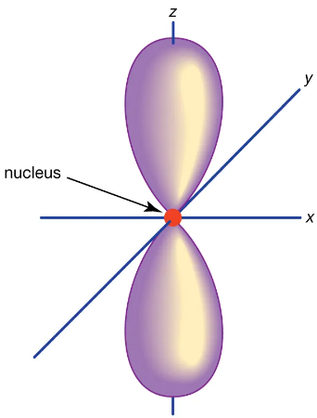
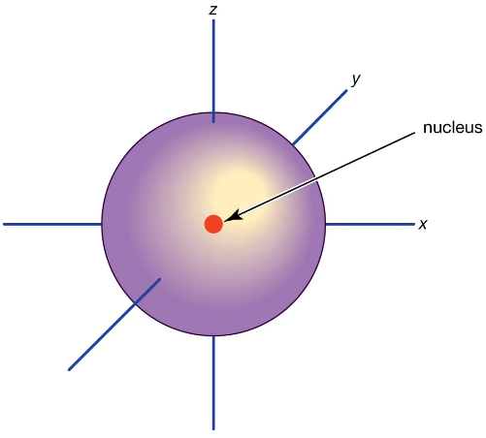

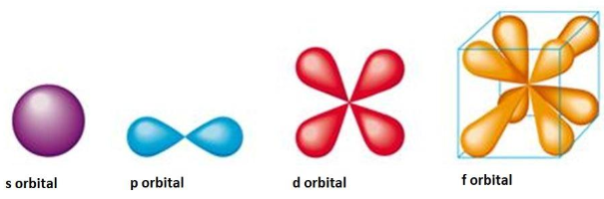
2. Secondary quantum numbers
Angular quantum numbers
It tells us the “shape” of the orbitals.
It has a small role in determining the energy of the electron
It specifies subshells, smaller groups of orbitals within a shell.
The values of l depend on the value of the n
It has possible integral values from 0,1,2… to (n - 1)
n = 1 l = 0 s-orbital
n = 2 l = 1 (0,1 sub-shells) p-orbital
n = 3 l = 2 (0,1,2 sub-shells) d-orbital
For example, for n = 3; the subshells will be 2s and 2p where 2 denotes the value of n, and s and p denote the values of l.
shell

Slide 11
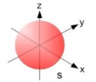
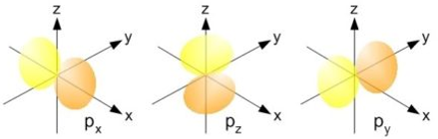
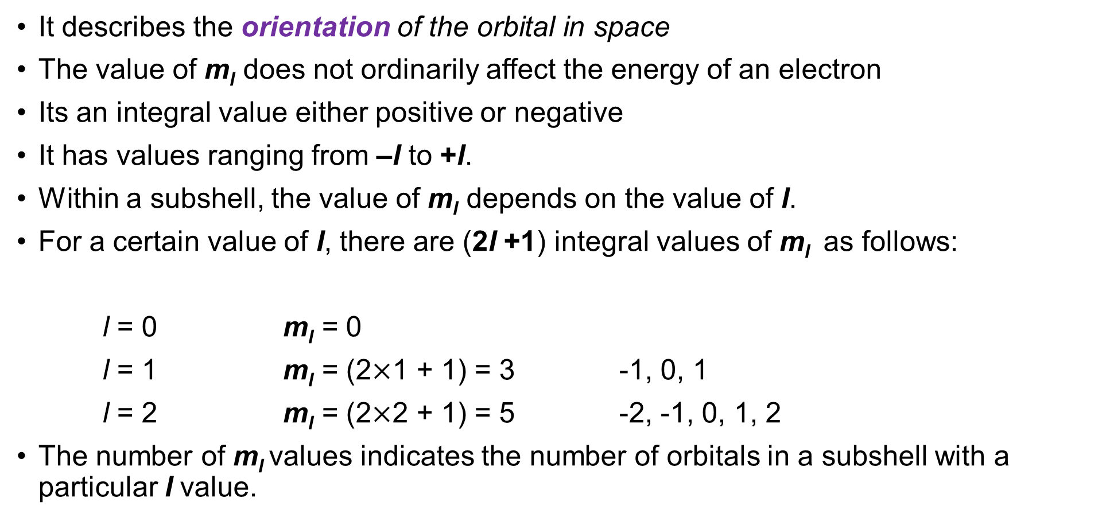
3.
It describes the orientation of the orbital in space
The value of m_{l} does not ordinarily affect the energy of an electron
Its an integral value either positive or negative
It has values ranging from –l to +l.
Within a subshell, the value of m_{l} depends on the value of l.
For a certain value of l, there are (2l +1) integral values of m_{l} as follows:
l = 0 m_{l} = 0
l = 1 m_{l} = (2$×$1 + 1) = 3 -1, 0, 1
l = 2 m_{l} = (2$×$2 + 1) = 5 -2, -1, 0, 1, 2
The number of m_{l} values indicates the number of orbitals in a subshell with a particular l value.

Slide 12
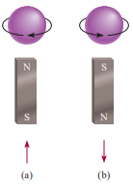

4. Electron spin quantum number (m_{s})
Experiments on the emission spectra of hydrogen and sodium atoms indicated that lines in the emission spectra could be split by the application of an external magnetic field.
The spin value gives the orientation of the magnetic field associated with the electron.
The value of m_{s} does not depend on the value of any other quantum number.
It may have values of $−_{2}^{1}$ or $+_{2}^{1}$.

Slide 13
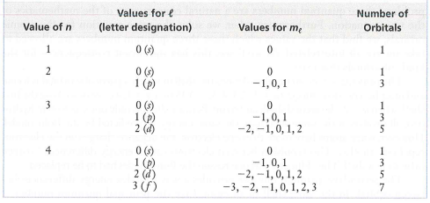
Relationships among values of different quantum numbers (n)

Slide 14

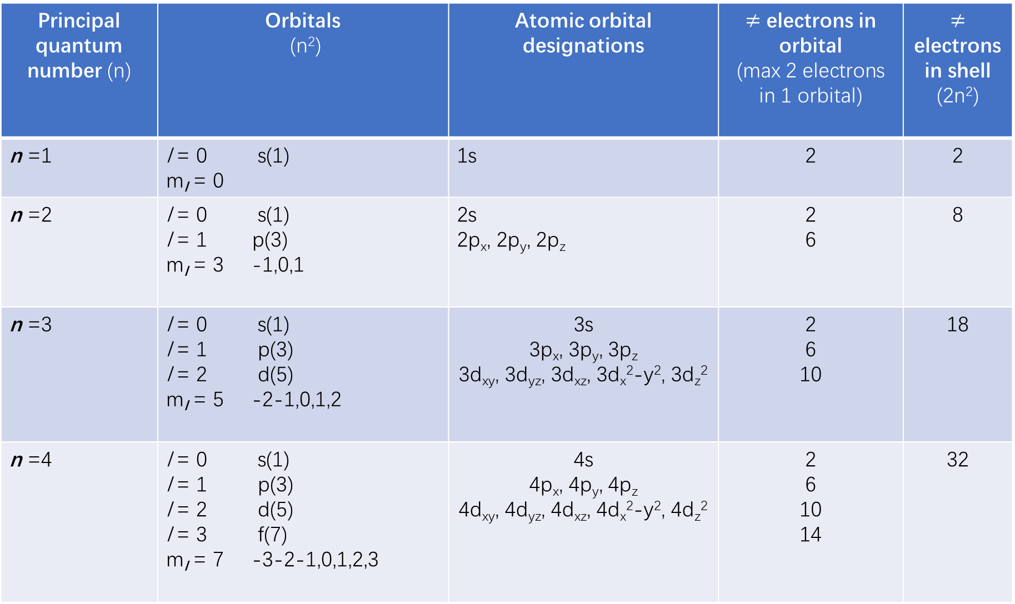
Principal quantum number (n) | Orbitals (n²) | Atomic orbital designations | $≠$ electrons in orbital (max 2 electrons in 1 orbital) | $≠$ electrons in shell (2n²)
n =1 | l = 0 s(1) m_{l} = 0 | 1s | 2 | 2
n =2 | l = 0 s(1) l = 1 p(3) m_{l} = 3 -1,0,1 | 2s 2p_{x}, 2p_{y}, 2p_{z} | 2 6 | 8
n =3 | l = 0 s(1) l = 1 p(3) l = 2 d(5) m_{l} = 5 -2-1,0,1,2 | 3s 3p_{x}, 3p_{y}, 3p_{z} 3d_{xy}, 3d_{yz}, 3d_{xz}, 3d_{x}²-y², 3d_{z}² | 2 6 10 | 18
n =4 | l = 0 s(1) l = 1 p(3) l = 2 d(5) l = 3 f(7) m_{l} = 7 -3-2-1,0,1,2,3 | 4s 4p_{x}, 4p_{y}, 4p_{z} 4d_{xy}, 4d_{yz}, 4d_{xz}, 4d_{x}²-y², 4d_{z}² | 2 6 10 14 | 32

Slide 15
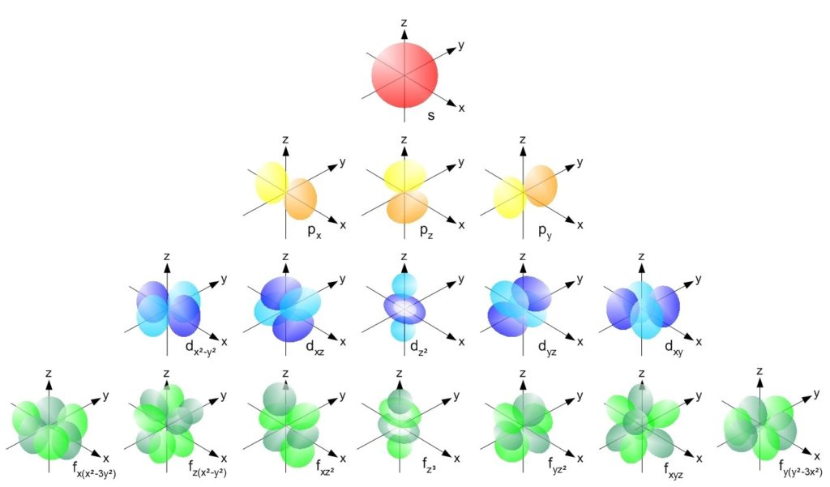
Atomic orbital orientations

Slide 16
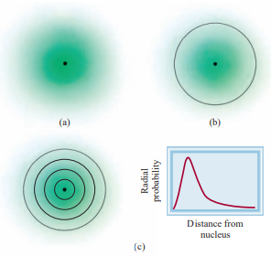
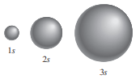
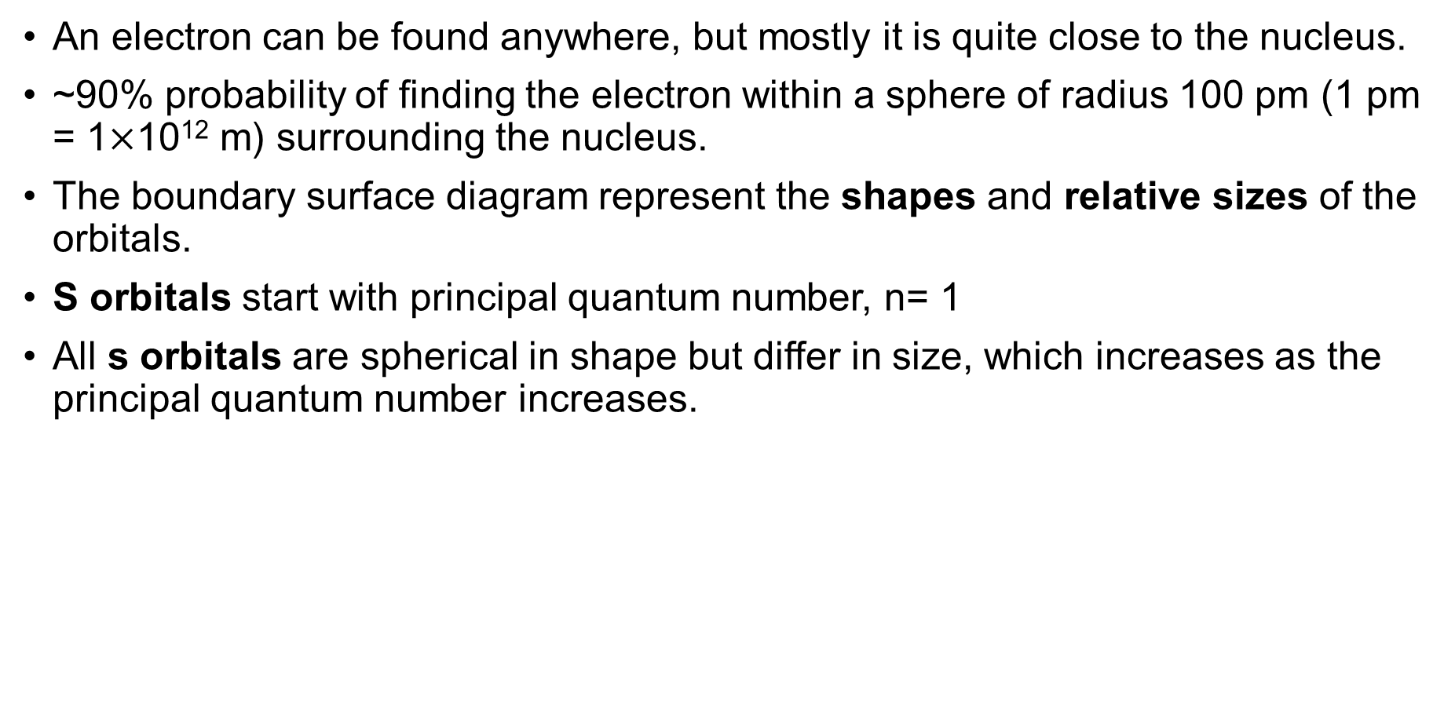
s Orbitals
An electron can be found anywhere, but mostly it is quite close to the nucleus.
~90% probability of finding the electron within a sphere of radius 100 pm (1 pm = 1$×$10¹² m) surrounding the nucleus.
The boundary surface diagram represent the shapes and relative sizes of the orbitals.
S orbitals start with principal quantum number, n= 1
All s orbitals are spherical in shape but differ in size, which increases as the principal quantum number increases.

Slide 17
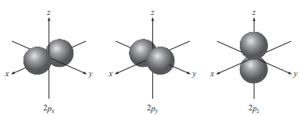
p Orbitals
p orbitals start with principal quantum number, n= 2
The three p orbitals are identical in size, shape, & energy; they differ in orientation.
Each p orbital can be thought of as two lobes on opposite sides of the nucleus.
Like s orbitals, p orbitals increase in size from 2p to 3p to 4p orbital and so on
Figure. Boundary surface diagrams of 2p orbitals

Slide 18
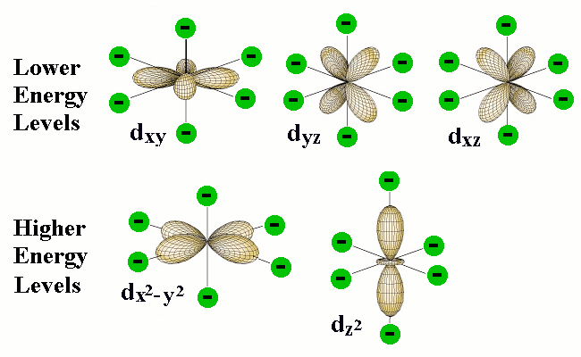
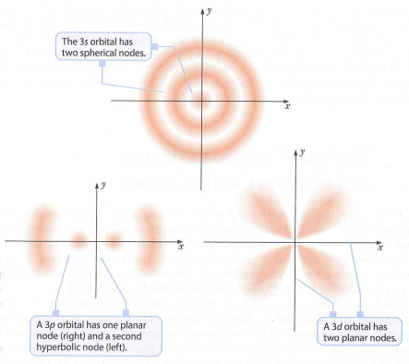
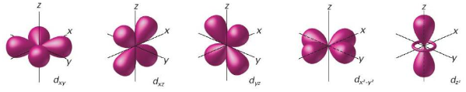
d Orbitals
d orbitals start with principal quantum number, n= 3
There are always 5 d-orbitals
All d orbitals are double dumbbell shaped except the last orbital (dumbbell with a doughnut) & generally lie between the axis
The d orbitals for which n is greater than 3 (4d, 5d, . . .) have similar shapes.

Slide 19
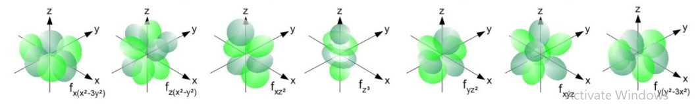
f orbitals
f orbitals start with principal quantum number, n= 4
There are 7 f orbitals in each n=4 and beyond
The f orbitals are important in accounting for the behavior of elements with atomic numbers >57.
their shapes are difficult to represent.
In general chemistry we are not concerned with orbitals having l values >3

Slide 20
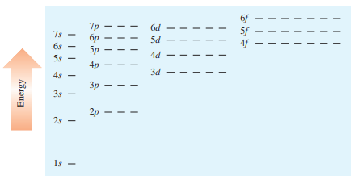
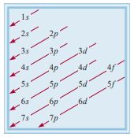
The Energies of Orbitals
How energy levels affect the actual arrangement of electrons in atoms
energy of an electron in a hydrogen atom is determined solely by its principal quantum number (n)
Thus, the energies of hydrogen orbitals increase as follows:
The higher a subshell is placed, the higher the energy of that subshell.
The specific energy levels vary from one element to another.
Energy of atomic orbitals will increase with increasing the value of quantum number (n)
Figure 2 depicts the order in which atomic orbitals are filled in a many electron atom.

Slide 21
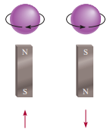
Pauli exclusion principal
Pauli exclusion principle (Austrian physicist Wolfgang Pauli) is used to determine electron configurations.
It is one of the fundamental principles of quantum mechanics.
This principle states that no two electrons in an atom can have the same four quantum numbers.
If two electrons in an atom should have the same n, l, and m_{l} values (that is, these two electrons are in the same atomic orbital), then they must have different values of m_{s}.
Each atomic orbital can contain at most two electrons but with opposite spin one with ‘clockwise spin’ and another with ‘counterclockwise spin’.
Electron configuration: how the electrons are distributed among the various atomic orbitals

Slide 22

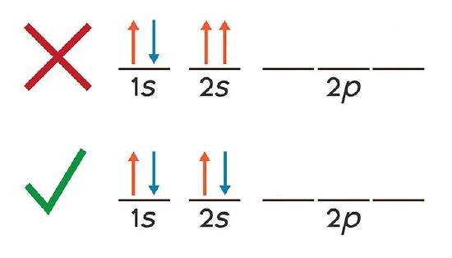
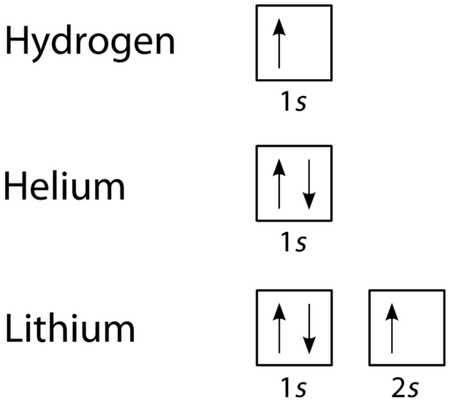

Pauli exclusion principal
The three possible ways of placing two electrons in the 1s orbital are as follows:
In (a), both electrons have the same upward spin.
in (b), both electrons have downward spins.
Only the configuration in (c) is physically acceptable

Slide 23
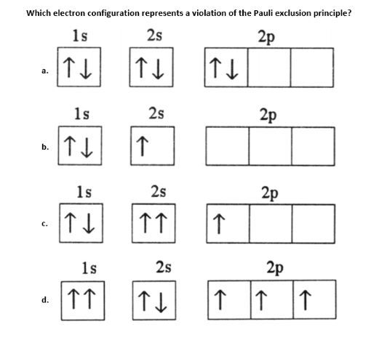
Exercise

Slide 24
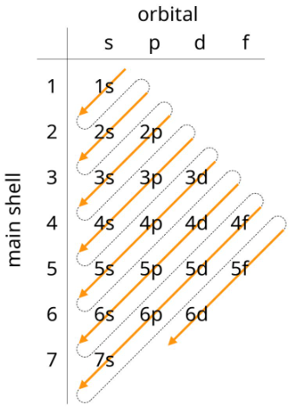



Aufbau Principal
Aufbau comes up from German word means ‘build-up’
Electrons are filled in the orbits from the lowest energy levels and then highest energy levels
Electrons will fill up the 1s orbital first, then 2s, and 2p and 3s, then 3p, 4s and so on
Paramagnetic substances contain net unpaired spins and are attracted by a magnet
Diamagnetic substances do not contain net unpaired spins and are slightly repelled by a magnet

Slide 25
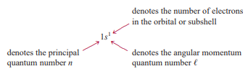

Slide 26
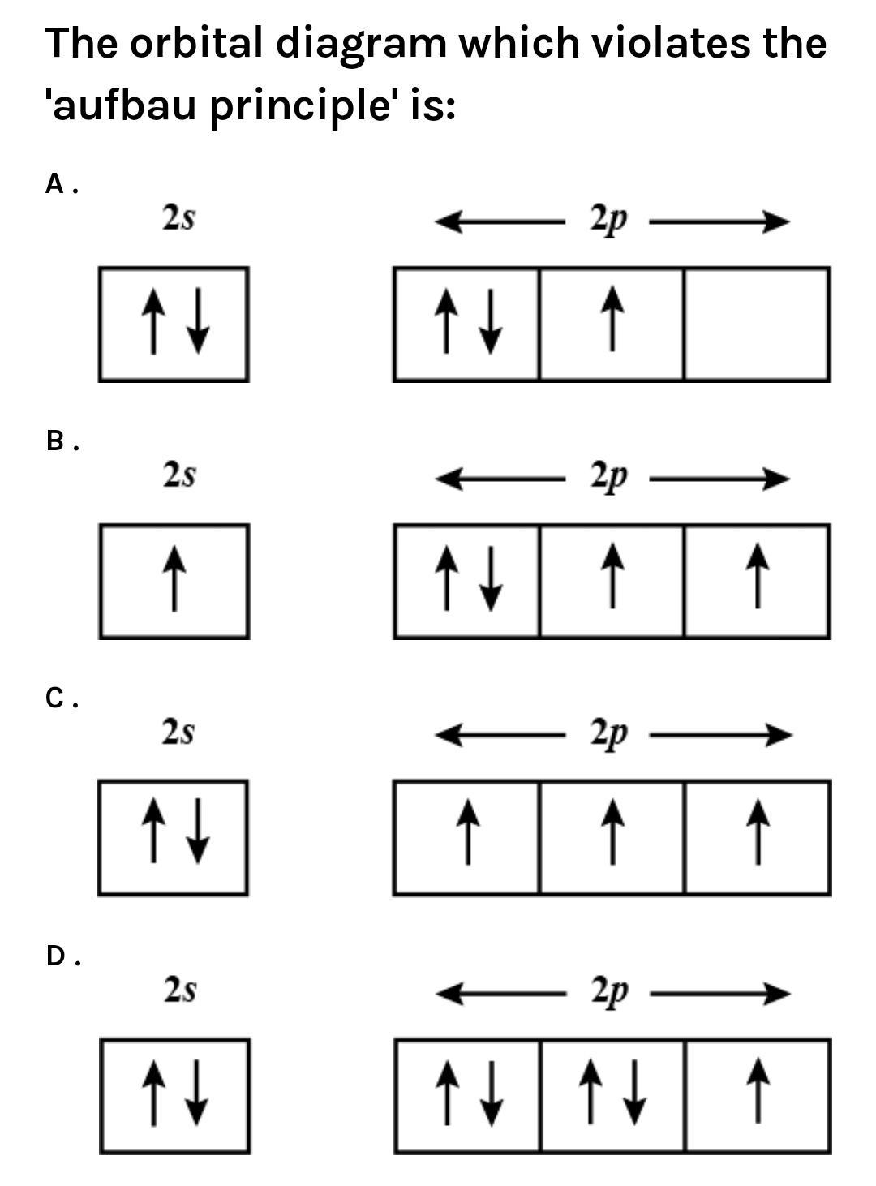
Exercise

Slide 27


Hund’s rule
Frederick Hund was a German physicist
Hund’s rule which states that the most stable arrangement of electrons in subshells is the one with the greatest number of parallel spins.
The electron configuration of carbon (Z = 6) is 1s² 2s² 2p²
which configuration will give the greatest stability?
In both (a) and (b) the two spins cancel each other.
The arrangement shown in (c) satisfies this condition.

Slide 28


Hund’s rule
The electron configuration of oxygen (Z = 8) is 1s² 2s² 2p⁴ .

Slide 29



Practice exercise
Fluorine (Z =9)
1s ² 2s ² 2p⁵
Neon (Z =10)
1s ² 2s ² 2p⁶
Sulfur (Z= 16)
1s² 2s² 2p⁶ 3s² 3p⁴

Slide 30
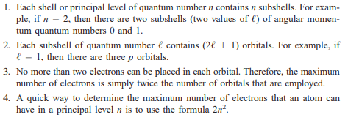
General Rules for Assigning Electrons to Atomic Orbitals

Slide 31
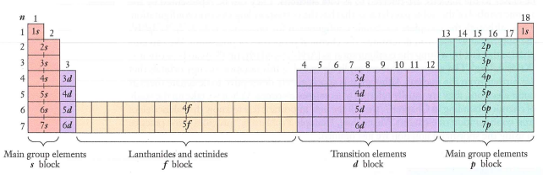
Periodic table & electronic configuration

